Slide 1
TCP Congestion Control
TCP congestion control was introduced into the Internet in the late 1980s by Van Jacobson, roughly eight years after the TCP/IP protocol stack had become operational.
Immediately preceding this time, the Internet was suffering from congestion collapse—
  hosts would send their packets into the Internet as fast as the advertised window would allow, congestion would occur at some router (causing packets to be dropped), and the hosts would time out and retransmit their packets, resulting in even more congestion

Slide 2
TCP Congestion Control
The idea of TCP congestion control is for each source to determine how much capacity is available in the network, so that it knows how many packets it can safely have in transit.
  Once a given source has this many packets in transit, it uses the arrival of an ACK as a signal that one of its packets has left the network, and that it is therefore safe to insert a new packet into the network without adding to the level of congestion.
  By using ACKs to pace the transmission of packets, TCP is said to be self-clocking.

Slide 3
TCP Congestion Control
Additive Increase Multiplicative Decrease
  TCP maintains a new state variable for each connection, called CongestionWindow, which is used by the source to limit how much data it is allowed to have in transit at a given time.
  The congestion window is congestion control’s counterpart to flow control’s advertised window.
  TCP is modified such that the maximum number of bytes of unacknowledged data allowed is now the minimum of the congestion window and the advertised window

Slide 4
TCP Congestion Control
Additive Increase Multiplicative Decrease
  TCP’s effective window is revised as follows:
    MaxWindow = MIN(CongestionWindow, AdvertisedWindow)
    EffectiveWindow = MaxWindow − (LastByteSent − LastByteAcked).
  That is, MaxWindow replaces AdvertisedWindow in the calculation of EffectiveWindow.
  Thus, a TCP source is allowed to send no faster than the slowest component—the network or the destination host—can accommodate.

Slide 5
TCP Congestion Control
Additive Increase Multiplicative Decrease
  The problem, of course, is how TCP comes to learn an appropriate value for CongestionWindow.
  Unlike the AdvertisedWindow, which is sent by the receiving side of the connection, there is no one to send a suitable CongestionWindow to the sending side of TCP.
    The answer is that the TCP source sets the CongestionWindow based on the level of congestion it perceives to exist in the network.
    This involves decreasing the congestion window when the level of congestion goes up and increasing the congestion window when the level of congestion goes down. Taken together, the mechanism is commonly called additive increase/multiplicative decrease (AIMD)

Slide 6
TCP Congestion Control
Additive Increase Multiplicative Decrease
  The key question, then, is how does the source determine that the network is congested and that it should decrease the congestion window?
    The answer is based on the observation that the main reason packets are not delivered, and a timeout results, is that a packet was dropped due to congestion. It is rare that a packet is dropped because of an error during transmission.
    Therefore, TCP interprets timeouts as a sign of congestion and reduces the rate at which it is transmitting.
    Specifically, each time a timeout occurs, the source sets CongestionWindow to half of its previous value. This halving of the CongestionWindow for each timeout corresponds to the “multiplicative decrease” part of AIMD.

Slide 7
TCP Congestion Control
Additive Increase Multiplicative Decrease
  Although CongestionWindow is defined in terms of bytes, it is easiest to understand multiplicative decrease if we think in terms of whole packets.
    For example, suppose the CongestionWindow is currently set to 16 packets. If a loss is detected, CongestionWindow is set to 8.
    Additional losses cause CongestionWindow to be reduced to 4, then 2, and finally to 1 packet.
    CongestionWindow is not allowed to fall below the size of a single packet, or in TCP terminology, the maximum segment size (MSS).

Slide 8
TCP Congestion Control
Additive Increase Multiplicative Decrease
  A congestion-control strategy that only decreases the window size is obviously too conservative.
  We also need to be able to increase the congestion window to take advantage of newly available capacity in the network.
  This is the “additive increase” part of AIMD, and it works as follows.
    Every time the source successfully sends a CongestionWindow’s worth of packets—that is, each packet sent out during the last RTT has been ACKed—it adds the equivalent of 1 packet to CongestionWindow.

Slide 9
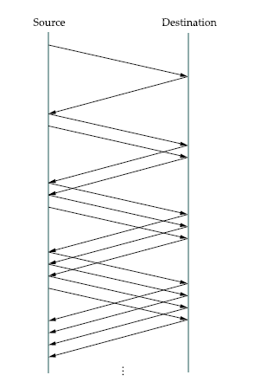
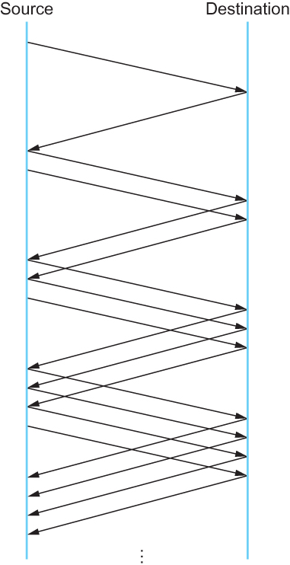
TCP Congestion Control
Additive Increase Multiplicative Decrease
Packets in transit during additive increase, with one packet being added each RTT.

Slide 10
TCP Congestion Control
Additive Increase Multiplicative Decrease
  Note that in practice, TCP does not wait for an entire window’s worth of ACKs to add 1 packet’s worth to the congestion window, but instead increments CongestionWindow by a little for each ACK that arrives.
  Specifically, the congestion window is incremented as follows each time an ACK arrives:
    Increment = MSS × (MSS/CongestionWindow)
    CongestionWindow+= Increment
    That is, rather than incrementing CongestionWindow by an entire MSS bytes each RTT, we increment it by a fraction of MSS every time an ACK is received.
    Assuming that each ACK acknowledges the receipt of MSS bytes, then that fraction is MSS/CongestionWindow.

Slide 11
TCP Congestion Control
Slow Start
  The additive increase mechanism just described is the right approach to use when the source is operating close to the available capacity of the network, but it takes too long to ramp up a connection when it is starting from scratch.
  TCP therefore provides a second mechanism, ironically called slow start, that is used to increase the congestion window rapidly from a cold start.
  Slow start effectively increases the congestion windowexponentially, rather than linearly.

Slide 12
TCP Congestion Control
Slow Start
  Specifically, the source starts out by setting CongestionWindow to one packet.
  When the ACK for this packet arrives, TCP adds 1 to CongestionWindow and then sends two packets.
  Upon receiving the corresponding two ACKs, TCP increments CongestionWindow by 2—one for each ACK—and next sends four packets.
  The end result is that TCP effectively doubles the number of packets it has in transit every RTT.

Slide 13
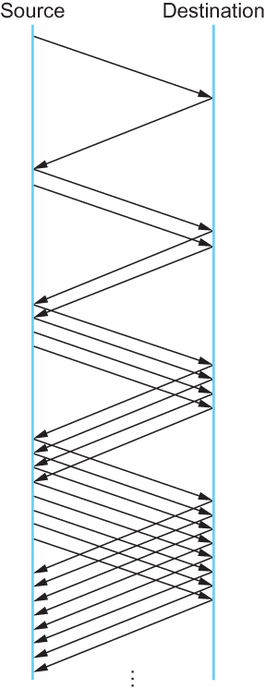
TCP Congestion Control
Slow Start
Packets in transit during slow start.

Slide 14
TCP Congestion Control
Slow Start
  There are actually two different situations in which slow start runs.
    The first is at the very beginning of a connection, at which time the source has no idea how many packets it is going to be able to have in transit at a given time.
      In this situation, slow start continues to double CongestionWindow each RTT until there is a loss, at which time a timeout causes multiplicative decrease to divide CongestionWindow by 2.

Slide 15
TCP Congestion Control
Slow Start
  There are actually two different situations in which slow start runs.
    The second situation in which slow start is used is a bit more subtle; it occurs when the connection goes dead while waiting for a timeout to occur.
      Recall how TCP’s sliding window algorithm works—when a packet is lost, the source eventually reaches a point where it has sent as much data as the advertised window allows, and so it blocks while waiting for an ACK that will not arrive.
      Eventually, a timeout happens, but by this time there are no packets in transit, meaning that the source will receive no ACKs to “clock” the transmission of new packets.
      The source will instead receive a single cumulative ACK that reopens the entire advertised window, but as explained above, the source then uses slow start to restart the flow of data rather than dumping a whole window’s worth of data on the network all at once.

Slide 16
TCP Congestion Control
Slow Start
  Although the source is using slow start again, it now knows more information than it did at the beginning of a connection.
  Specifically, the source has a current (and useful) value of CongestionWindow; this is the value of CongestionWindow that existed prior to the last packet loss, divided by 2 as a result of the loss.
  We can think of this as the “target” congestion window.
  Slow start is used to rapidly increase the sending rate up to this value, and then additive increase is used beyond this point.

Slide 17
TCP Congestion Control
Slow Start
  Notice that we have a small bookkeeping problem to take care of, in that we want to remember the “target” congestion window resulting from multiplicative decrease as well as the “actual” congestion window being used by slow start.
  To address this problem, TCP introduces a temporary variable to store the target window, typically called CongestionThreshold, that is set equal to the CongestionWindow value that results from multiplicative decrease.

Slide 18
TCP Congestion Control
Slow Start
  The variable CongestionWindow is then reset to one packet, and it is incremented by one packet for every ACK that is received until it reaches.
  CongestionThreshold, at which point it is incremented by one packet per RTT.

Slide 19
TCP Congestion Control
Slow Start
  In other words, TCP increases the congestion window as defined by the following code fragment:
{
u_int cw = state->CongestionWindow;
u_int incr = state->maxseg;
if (cw > state->CongestionThreshold)
incr = incr * incr / cw;
state->CongestionWindow = MIN(cw + incr, TCP_MAXWIN);
}
    where state represents the state of a particular TCP connection and TCP MAXWIN defines an upper bound on how large the congestion window is allowed to grow.

Slide 20
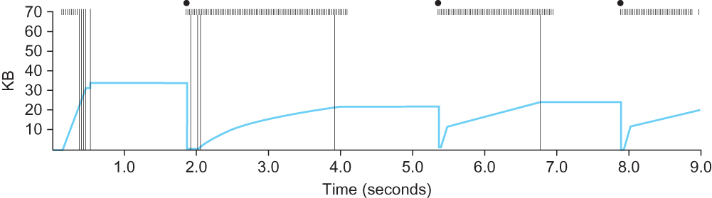
TCP Congestion Control
Slow Start
Behavior of TCP congestion control. Colored line = value of CongestionWindow over time; solid bullets at top of graph = timeouts; hash marks at top of graph = time when each packet is transmitted; vertical bars = time when a packet that was eventually retransmitted was first transmitted.

Slide 21
TCP Congestion Control
Fast Retransmit and Fast Recovery
  The mechanisms described so far were part of the original proposal to add congestion control to TCP.
  It was soon discovered, however, that the coarse-grained implementation of TCP timeouts led to long periods of time during which the connection went dead while waiting for a timer to expire.
  Because of this, a new mechanism called fast retransmit was added to TCP.
  Fast retransmit is a heuristic that sometimes triggers the retransmission of a dropped packet sooner than the regular timeout mechanism.

Slide 22
TCP Congestion Control
Fast Retransmit and Fast Recovery
  The idea of fast retransmit is straightforward. Every time a data packet arrives at the receiving side, the receiver responds with an acknowledgment, even if this sequence number has already been acknowledged.
  Thus, when a packet arrives out of order— that is, TCP cannot yet acknowledge the data the packet contains because earlier data has not yet arrived—TCP resends the same acknowledgment it sent the last time.

Slide 23
TCP Congestion Control
Fast Retransmit and Fast Recovery
  This second transmission of the same acknowledgment is called a duplicate ACK.
  When the sending side sees a duplicate ACK, it knows that the other side must have received a packet out of order, which suggests that an earlier packet might have been lost.
  Since it is also possible that the earlier packet has only been delayed rather than lost, the sender waits until it sees some number of duplicate ACKs and then retransmits the missing packet. In practice, TCP waits until it has seen three duplicate ACKs before retransmitting the packet.

Slide 24
TCP Congestion Control
Fast Retransmit and Fast Recovery
  When the fast retransmit mechanism signals congestion, rather than drop the congestion window all the way back to one packet and run slow start, it is possible to use the ACKs that are still in the pipe to clock the sending of packets.
  This mechanism, which is called fast recovery, effectively removes the slow start phase that happens between when fast retransmit detects a lost packet and additive increase begins.

Slide 25
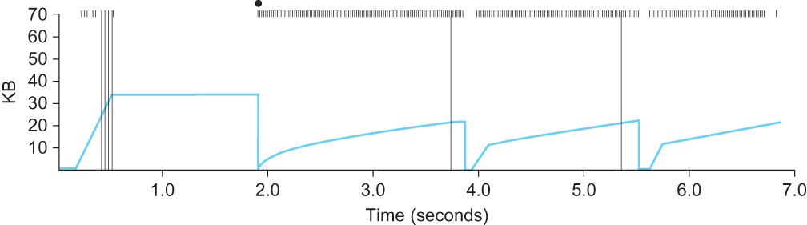
TCP Congestion Control
Fast Retransmit and Fast Recovery
Trace of TCP with fast retransmit. Colored line = CongestionWindow;
solid bullet = timeout; hash marks = time when each packet is transmitted; vertical bars = time when a packet that was eventually retransmitted was first transmitted.

Slide 26
Congestion Avoidance Mechanism
It is important to understand that TCP’s strategy is to control congestion once it happens, as opposed to trying to avoid congestion in the first place.
In fact, TCP repeatedly increases the load it imposes on the network in an effort to find the point at which congestion occurs, and then it backs off from this point.
An appealing alternative, but one that has not yet been widely adopted, is to predict when congestion is about to happen and then to reduce the rate at which hosts send data just before packets start being discarded.
We call such a strategy congestion avoidance, to distinguish it from congestion control.

Slide 27
Congestion Avoidance Mechanism
DEC Bit
  The first mechanismwas developed for use on the Digital Network Architecture (DNA), a connectionless network with a connection-oriented transport protocol.
  This mechanism could, therefore, also be applied to TCP and IP.
  As noted above, the idea here is to more evenly split the responsibility for congestion control between the routers and the end nodes.

Slide 28
Congestion Avoidance Mechanism
DEC Bit
  Each router monitors the load it is experiencing and explicitly notifies the end nodes when congestion is about to occur.
  This notification is implemented by setting a binary congestion bit in the packets that flow through the router; hence the name DECbit.
  The destination host then copies this congestion bit into the ACK it sends back to the source.
  Finally, the source adjusts its sending rate so as to avoid congestion

Slide 29
Congestion Avoidance Mechanism
DEC Bit
  A single congestion bit is added to the packet header. A router sets this bit in a packet if its average queue length is greater than or equal to 1 at the time the packet arrives.
  This average queue length is measured over a time interval that spans the last busy+idle cycle, plus the current busy cycle.

Slide 30
Congestion Avoidance Mechanism
DEC Bit
  Essentially, the router calculates the area under the curve and divides this value by the time interval to compute the average queue length.
  Using a queue length of 1 as the trigger for setting the congestion bit is a trade-off between significant queuing (and hence higher throughput) and increased idle time (and hence lower delay).
  In other words, a queue length of 1 seems to optimize the power function.

Slide 31
Congestion Avoidance Mechanism
DEC Bit
  The source records how many of its packets resulted in some router setting the congestion bit.
  In particular, the source maintains a congestion window, just as in TCP, and watches to see what fraction of the last window’s worth of packets resulted in the bit being set.

Slide 32
Congestion Avoidance Mechanism
DEC Bit
  If less than 50% of the packets had the bit set, then the source increases its congestion window by one packet.
  If 50% or more of the last window’s worth of packets had the congestion bit set, then the source decreases its congestion window to 0.875 times the previous value.

Slide 33
Congestion Avoidance Mechanism
DEC Bit
  The value 50% was chosen as the threshold based on analysis that showed it to correspond to the peak of the power curve. The “increase by 1, decrease by 0.875” rule was selected because additive increase/multiplicative decrease makes the mechanism stable.

Slide 34
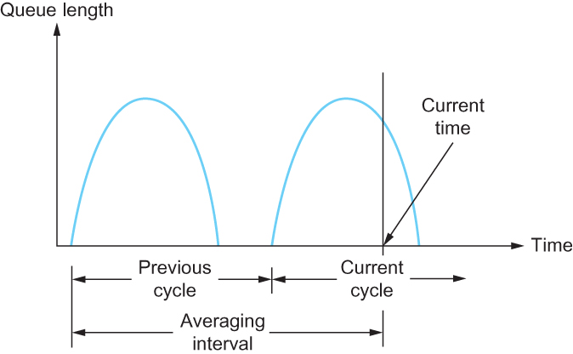
Congestion Avoidance Mechanism
DEC Bit
Computing average queue length at a router

Slide 35
Congestion Avoidance Mechanism
Random Early Detection (RED)
  A second mechanism, called random early detection (RED), is similar to the DECbit scheme in that each router is programmed to monitor its own queue length, and when it detects that congestion is imminent, to notify the source to adjust its congestion window. RED, invented by Sally Floyd and Van Jacobson in the early 1990s, differs from the DECbit scheme in two major ways:

Slide 36
Congestion Avoidance Mechanism
Random Early Detection (RED)
  The first is that rather than explicitly sending a congestion notification message to the source, RED is most commonly implemented such that it implicitly notifies the source of congestion by dropping one of its packets.
  The source is, therefore, effectively notified by the subsequent timeout or duplicate ACK.
  RED is designed to be used in conjunction with TCP, which currently detects congestion by means of timeouts (or some other means of detecting packet loss such as duplicate ACKs).

Slide 37
Congestion Avoidance Mechanism
Random Early Detection (RED)
  As the “early” part of the RED acronym suggests, the gateway drops the packet earlier than it would have to, so as to notify the source that it should decrease its congestion window sooner than it would normally have.
  In other words, the router drops a few packets before it has exhausted its buffer space completely, so as to cause the source to slow down, with the hope that this will mean it does not have to drop lots of packets later on.

Slide 38
Congestion Avoidance Mechanism
Random Early Detection (RED)
  The second difference between RED and DECbit is in the details of how RED decides when to drop a packet and what packet it decides to drop.
  To understand the basic idea, consider a simple FIFO queue. Rather than wait for the queue to become completely full and then be forced to drop each arriving packet, we could decide to drop each arriving packet with some drop probability whenever the queue length exceeds some drop level.
  This idea is called early random drop. The RED algorithm defines the details of how to monitor the queue length and when to drop a packet.

Slide 39
Congestion Avoidance Mechanism
Random Early Detection (RED)
  First, RED computes an average queue length using a weighted running average similar to the one used in the original TCP timeout computation. That is, AvgLen is computed as
    AvgLen = (1 − Weight) × AvgLen + Weight × SampleLen
    where 0 < Weight < 1 and SampleLen is the length of the queue when a sample measurement is made.
  In most software implementations, the queue length is measured every time a new packet arrives at the gateway.
  In hardware, it might be calculated at some fixed sampling interval.

Slide 40
Congestion Avoidance Mechanism
Random Early Detection (RED)
  Second, RED has two queue length thresholds that trigger certain activity: MinThreshold and MaxThreshold.
  When a packet arrives at the gateway, RED compares the current AvgLen with these two thresholds, according to the following rules:
    if AvgLen ≤ MinThreshold
      → queue the packet
    if MinThreshold < AvgLen < MaxThreshold
      → calculate probability P
      → drop the arriving packet with probability P
    if MaxThreshold ≤ AvgLen
      → drop the arriving packet

Slide 41
Congestion Avoidance Mechanism
Random Early Detection (RED)
  P is a function of both AvgLen and how long it has been since the last packet was dropped.
  Specifically, it is computed as follows:
    TempP = MaxP × (AvgLen − MinThreshold)/(MaxThreshold − MinThreshold)
    P = TempP/(1 − count × TempP)

Slide 42
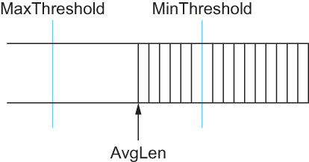
Congestion Avoidance Mechanism
Random Early Detection (RED)
RED thresholds on a FIFO queue

Slide 43
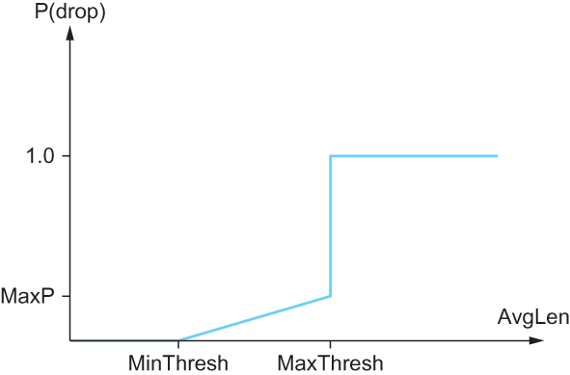
Congestion Avoidance Mechanism
Random Early Detection (RED)
Drop probability function for RED

Slide 44
Congestion Avoidance Mechanism
Source-based Congestion Avoidance
  The general idea of these techniques is to watch for some sign from the network that some router’s queue is building up and that congestion will happen soon if nothing is done about it.
  For example, the source might notice that as packet queues build up in the network’s routers, there is a measurable increase in the RTT for each successive packet it sends.

Slide 45
Congestion Avoidance Mechanism
Source-based Congestion Avoidance
  One particular algorithm exploits this observation as follows:
    The congestion window normally increases as in TCP, but every two round-trip delays the algorithm checks to see if the current RTT is greater than the average of the minimum and maximum RTTs seen so far.
    If it is, then the algorithm decreases the congestion window by one-eighth.

Slide 46
Congestion Avoidance Mechanism
Source-based Congestion Avoidance
  A second algorithm does something similar. The decision as to whether or not to change the current window size is based on changes to both the RTT and the window size.
  The window is adjusted once every two round-trip delays based on the product
    (CurrentWindow − OldWindow)×(CurrentRTT − OldRTT)
    If the result is positive, the source decreases the window size by one-eighth;
    if the result is negative or 0, the source increases the window by one maximum packet size.
    Note that the window changes during every adjustment; that is, it oscillates around its optimal point.

